Slide 1
Predicting Public Passenger Vehicle Inspection Outcomes in Chicago
Student: Ricardo Caster
Ariel University
Course: Advanced Topics in Machine Learning
Lecturer: פרופ' חג'ג' חן

Slide 2
Problem Definition
Predict whether a public passenger vehicle will FAIL inspection
Goal: identify risky vehicles before inspection
Important for safety, regulation, and resource allocation
Notes:
Failure prediction matters more than pass prediction, especially for public safety.

Slide 3
Project Goals
Predictive Modeling: Develop a supervised ML pipeline to classify "PASSED" vs "FAILED" outcomes.
Safety Priority: Maximize the detection of mechanical failures (Recall).
Fleet Insight: Use unsupervised learning to discover hidden risk profiles and anomalies.
Feature Validation: Conduct an ablation study to prove which features truly drive inspection results.
Notes:
Emphasize recall: missing a failure is more costly than a false alarm.

Slide 4
Related Methods
Binary classification for risk prediction
Clustering for risk profiling
Anomaly detection for unusual vehicles
Imbalance Handling: Real-world inspection data is skewed toward "PASS"; used class weighting to address this.
Time Analysis: Explored the impact of scheduling (Month/Hour) on vehicle failure.
Notes:
Both supervised and unsupervised learning are used for complementary insights.

Slide 5
Dataset & Features
Chicago Public Passenger Vehicle Inspections(35,310 raw records)
Target: FAILED (1) vs PASSED (0) inspection
Key features:
Vehicle Age: (Current Year - Model Year)
Categorical: Vehicle Type, Make, Model, Company Name, Affiliation
Operational: Inspection Type, Vehicle Status.

Slide 6
Methodology
Preprocessing: Imputation, scaling, one-hot encoding
Supervised Models:
Logistic Regression
Random Forest
XGBoost
SVM
KNN
Unsupervised Techniques:
K-Means: To group vehicles into risk categories
Isolation Forest: To flag rare outliers
Evaluation: ROC-AUC, Recall, Precision, PR-AUC, accuracy

Slide 7
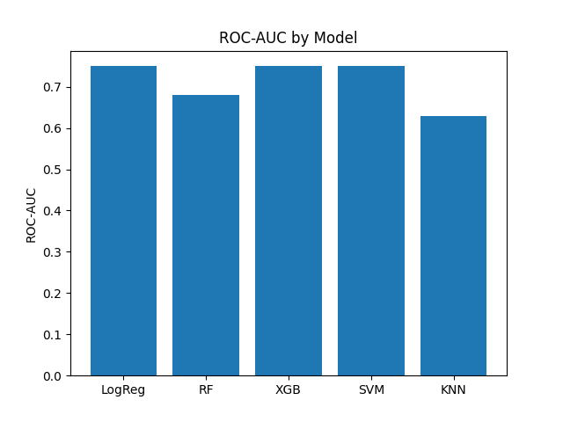
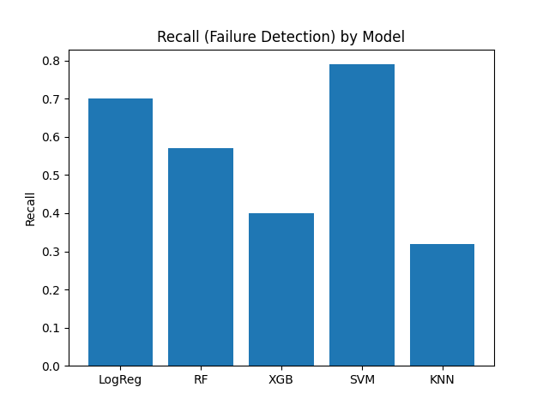
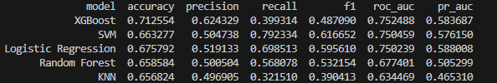
Supervised Learning Results
Notes:
SVM and Logistic Regression give the best tradeoff.
XGBoost has high accuracy but poor recall, which is risky for this problem.

Slide 8
Model Comparison
Best recall: SVM
Best balance: Logistic Regression
Tree models less stable on recall
Conclusion:
SVM and Logistic Regression give the best tradeoff.
SVM is the best safety tool (highest Recall)
XGBoost has the highest accuracy but poor recall, which is risky for this problem because misses too many failures.

Slide 9
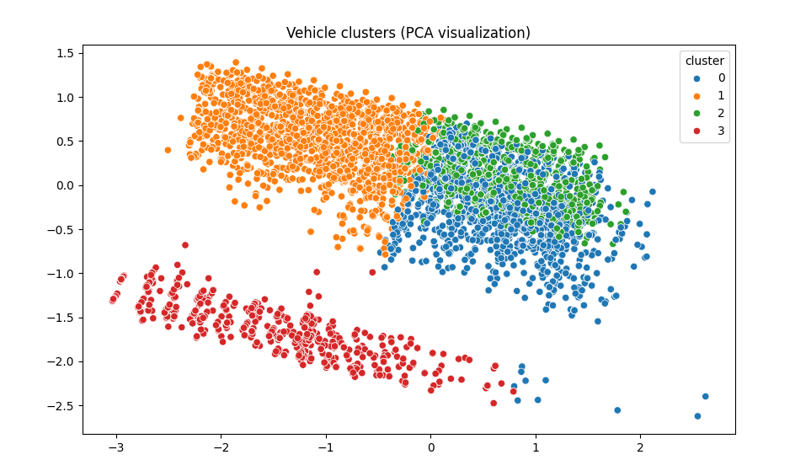
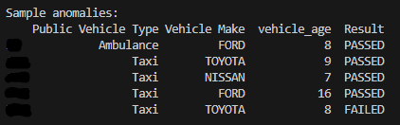
Unsupervised Insights - Used for insight, not prediction
K-Means reveals distinct risk profiles
The distance between the Red Cluster (3) and the others mathematically proves that these vehicles have fundamentally different mechanical or organizational characteristics
Cluster 3 Failure Rate: 37.2% (Highest Risk).
Isolation Forest detects rare vehicle patterns
Anomaly Rate: 2% (Unusual patterns detected).
Notes:
Unsupervised learning supports understanding, not decision automation.

Slide 10
Time Feature Analysis
Month & hour extracted previously
When Including time-based scheduling features, it resulted in a ROC-AUC of 0.751, nearly identical to the baseline model.
This demonstrates that scheduling time does not meaningfully contribute to predicting inspection outcomes.
NOT RELEVAN FOR final model

Slide 11
Conclusion
Timing features add no meaningful value (Ablation result: +0.001 AUC improvement)
Inspection failure is driven by Vehicle and organizational features
Model is interpretable, causal, and deployable
A risk-based scheduling system can successfully catch nearly 80% of failures (dangerous vehicles) using the SVM model.
Incorporating additional mechanical or historical inspection data into this public dataset would significantly enhance future predictive power.

Slide 12



